Slide 1
My day off

Slide 2
[ iː ] teeth, three, these, evening, tree, Pete
[ e ] bed, get, twelve, pet
[ əʊ ] nose, home, Rose, go, close, open, no
[ aʊ ] house, mouse, out

Slide 3
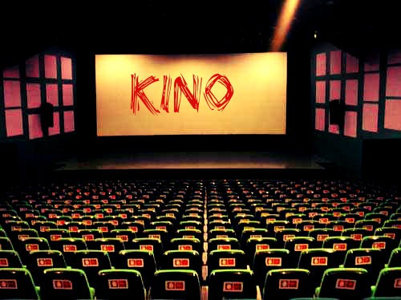
Where can you go on your day off?
We can go to …

Slide 4
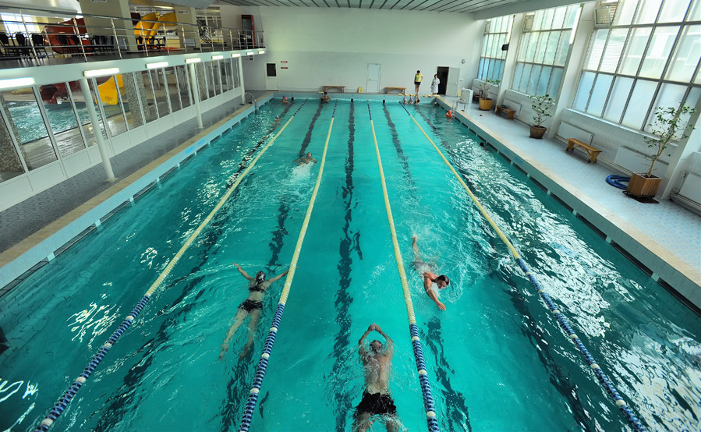
Where can you go on your day off?
We can …

Slide 5
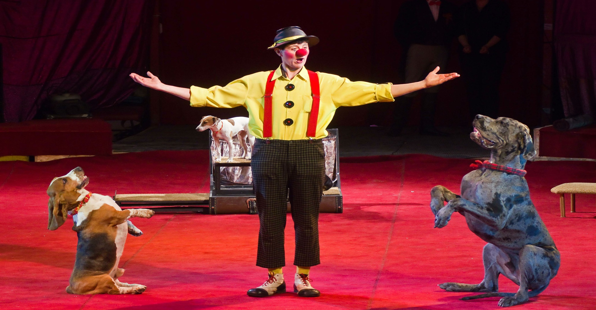
Where can you go on your day off?
We can go to …

Slide 6
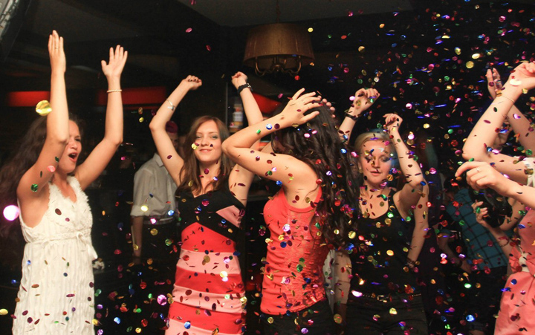
Where can you go on your day off?
We can go to …

Slide 7
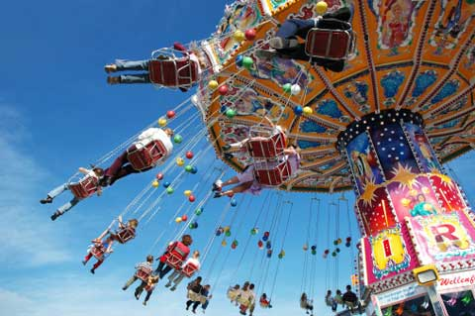
Where can you go on your day off?
We can go to …

Slide 8
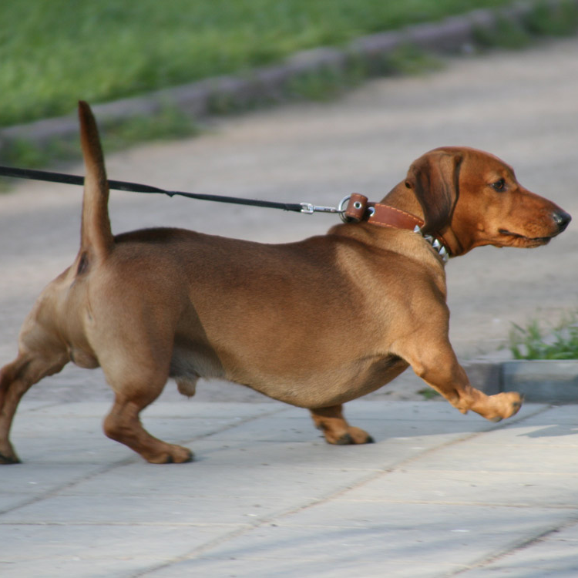
What can you do on your day off?
We can…

Slide 9
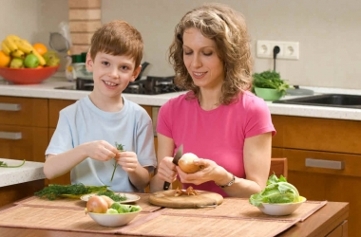
We can …
What can you do on your day off?

Slide 10
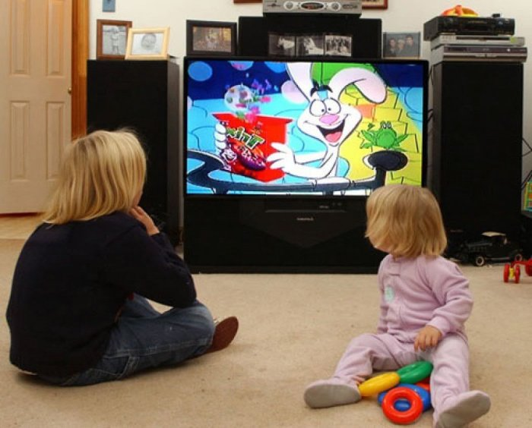
What can you do on your day off?

Slide 11
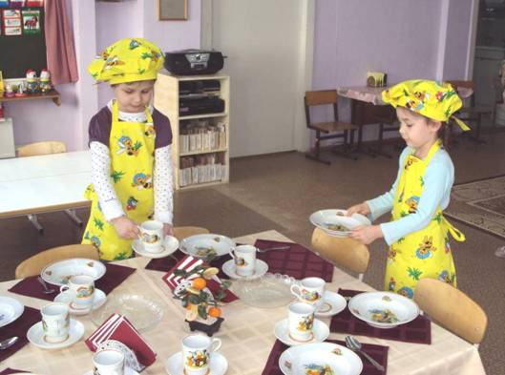
What can you do on your day off?

Slide 12
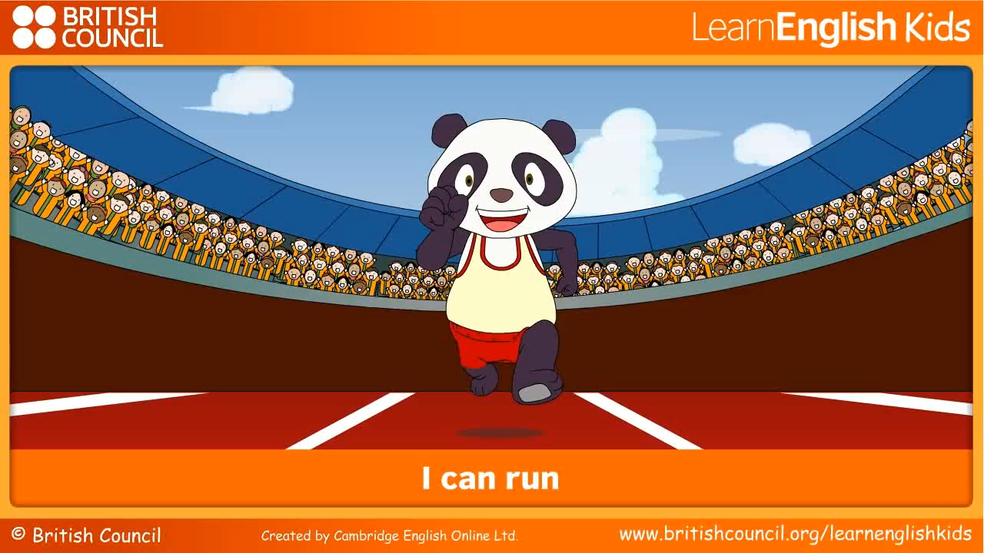

Slide 13


If you are happy – clap your hands.
If you are not happy – stamp your foot.

Slide 14
WELL DONE!!!

